Slide 1

Module 7: Using Intelligence Dashboards
0/5
Analytics: Advanced Application Developer

Slide 2
Module Objectives
After completing this module you will be able to:
  Create and edit a new dashboard
  Control drilldown display in dashboards
  Arrange dashboard sections horizontally
  Modify dashboard properties
  Change PDF and printing options in dashboards
  Create and assign saved selections in dashboards
Why you need to know:
  An understanding of these topics will improve your ability to create and modify Siebel Intelligence Dashboards, which are used to display the results of Siebel Analytics requests and personalized views of information

Slide 3
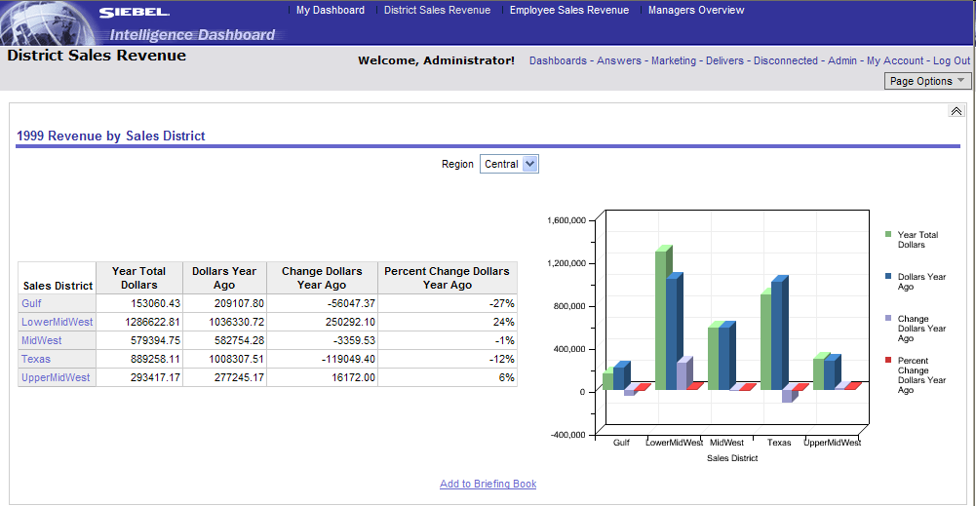
Intelligence Dashboard
Screen in an Analytics application used to display a personalized view of corporate and external information
  Saved Analytics requests
  Alerts from Siebel Delivers
  Links to Web sites and documents
  Images, charts, tables, text, folders
Accessible dashboards
Dashboard
Dashboard content

Slide 4
Key Intelligence Dashboard Terms
Definitions for key terms used in the creation of Siebel Intelligence Dashboards
Term | Description
Column | Used to align content on a dashboard
Section | Object within a column that holds the actual content
Dashboard Object | Items that are embedded in a dashboard (section is an example)
Page | Contain columns and sections that hold content
Results (reports) | Output of requests returned from Siebel Analytics Server
Skin | Control appearance of Siebel Analytics Web interface
Style | Control how dashboards and results are formatted for display
Web Catalog | Stores content created with Siebel Answers and Intelligence Dashboards
Builder | User or group that can modify a dashboard

Slide 5
Working with Intelligence Dashboards
0/7
Creating a New Dashboard
Opening Dashboard Editor
Using Dashboard Editor
Controlling Drilldown Display
Arranging Sections Horizontally
Modifying Dashboard Properties
Changing PDF and Printing Options

Slide 6
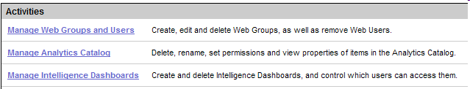
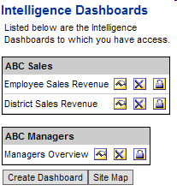
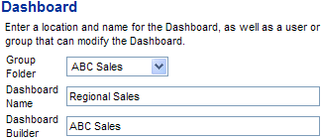
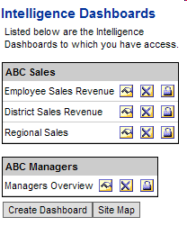
Creating a New Dashboard
1/7
Reserved for users with appropriate permissions and responsibilities
1. Admin
2. Manage Intelligence Dashboards
3. Create Dashboard
4. Location, name, builder
5. New dashboard

Slide 7
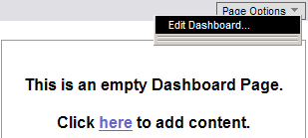
Opening Dashboard Editor
2/7
Open the Dashboard Editor to create dashboard layout and add content
Select Page Options > Edit Dashboard . . .
. . . or click here to open Dashboard Editor

Slide 8
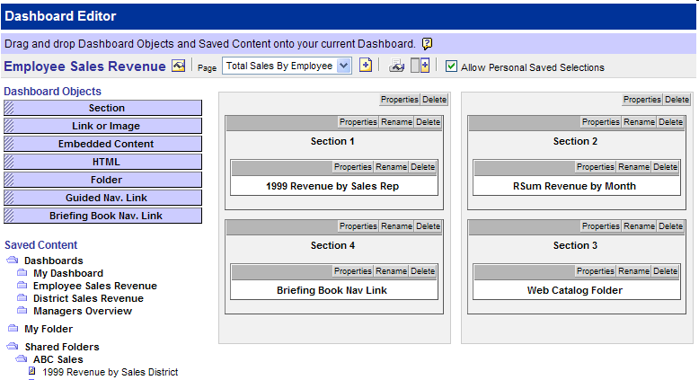
Using Dashboard Editor
3/7
Add dashboard content and modify dashboard layout
  Drag and drop objects and saved content into dashboard
Reserved for users with appropriate permissions
Properties
Page
Add page
Add column
Objects
Saved Content
Dragged Content
Section
Column
Column

Slide 9
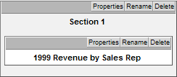
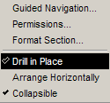

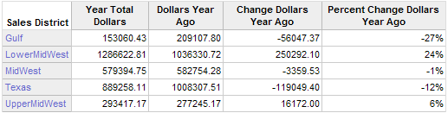
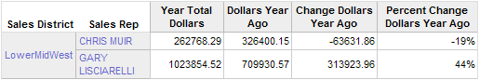
Controlling Drilldown Display
4/7
When a user drills down on an embedded request, there are two options for displaying results:
  Directly in dashboard, replacing original request
  In a new window, replacing entire dashboard
1. Click section Properties
2. Select Drill in Place to show results directly in dashboard
3. Drill down on request
4. Original request replaced with drilldown results

Slide 10
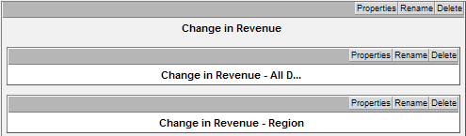
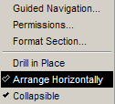
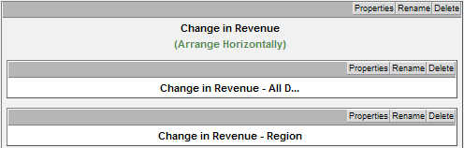
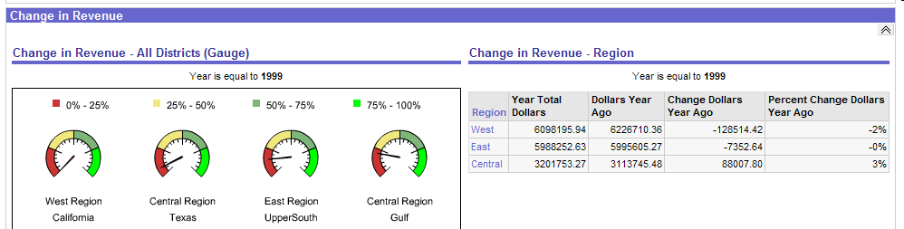
Arranging Sections Horizontally
5/7
Default alignment for objects in sections is vertical
1. Select Properties > Arrange Horizontally
Requests appear vertically in section
2. Arrange Horizontally displays in section
3. Requests display horizontally in dashboard

Slide 11
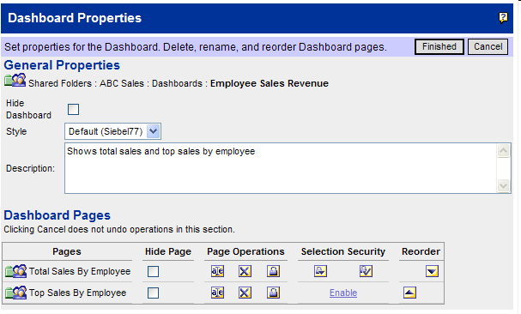
Modifying Dashboard Properties
6/7
Use the Dashboard Properties page to display or modify dashboard properties
Click Dashboard Properties in Dashboard Editor
Hide dashboard
Descriptions appear in Catalog Manager
Set style
Control shared selections
Set page permissions
Hide pages
Rename pages
Delete pages
Reorder pages

Slide 12
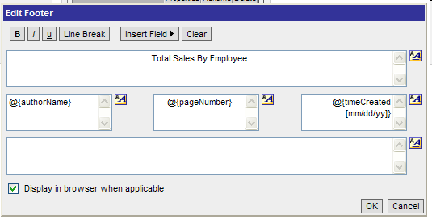
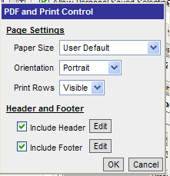
Changing PDF and Printing Options
7/7
Specify page settings and header and footer content for PDF output
Click PDF and Print Control button
Set page settings
Include header or footer
Edit header or footer
Result

Slide 13
Saved Selections
Allow users to view dashboard pages with most frequently used or favorite choices for filters and prompts pre-selected
  Eliminates need to choose prompts and filters manually
  Provides ability to
    Save multiple view selections with different combinations of choices, for personal use or use by others
    Switch between saved selections
    Specify saved selection as default view

Slide 14
Working with Saved Selections
0/4
Creating a Personal Saved Selection
Creating a Saved Selection for Others
Applying a Saved Selection
Editing Saved Selections

Slide 15



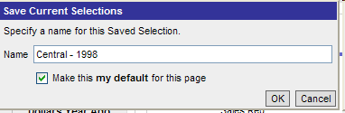
Creating a Personal Saved Selection
1/4
Users with appropriate permissions can create and save selections for personal use
Set prompt choice for dashboard
Save selection for personal use
Specify a name
Optional: make default

Slide 16
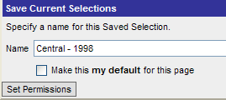
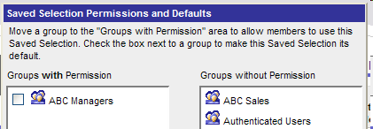
Creating a Saved Selection for Others
2/4
Users with appropriate permissions can create and save selections for others
Set prompt choice for dashboard
Save selection for others
Set permissions

Slide 17



Applying a Saved Selection
3/4
Use the Page Options button to apply saved selections
Select saved selection to apply
Default selection is bolded
Selection applied

Slide 18


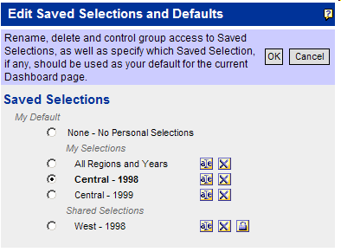
Editing Saved Selections
4/4
Users with appropriate permissions can edit saved selections and defaults
Select
Change defaults
Rename
Delete
Set permissions

Slide 19
Summary
This module showed you how to:
  Create and edit a new dashboard
  Control drilldown display in dashboards
  Arrange dashboard sections horizontally
  Modify dashboard properties
  Change PDF and printing options in dashboards
  Create and assign saved selections in dashboards

Slide 20
Lab
In the lab you will:
  Create and edit Siebel Intelligence Dashboards

